Slide 1
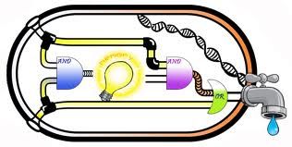

A SAT-based approach to Model Based Diagnosis
Credits:
Most of the slides are taken from Roni Stern
Some of the slides are taken from Hila Shalom and Eran Peer
The presented research is joint work with:
Amit Metodi, Roni Stern and Mike Codish

Slide 2
Agenda
What is the SATisfiability problem
Max SATisfiability (MAX-SAT)
Diagnosis and SAT
Minimal diagnosis with MAX SAT
Efficient SAT compilation of the MBD problem

Slide 3
A Logical Formula
Examples:
A And B
(C Or D) And E
F → (Not(G) And H)
A set of literals connected by logical operators
A, Not(A), B, Not(B), … are literals
And, Or and → are examples of logical operators
Assumption: a literal can either be True or False

Slide 4
Why Logical Formulas?

Slide 5
SATisfiability
Consider the formula: f = A And B
What values of A and B will make f=True?
How about the formula
f = (C→(A Or Not(B))→B
Causing f=True is called
“Satisfying the formula f”
The SAT problem:
Given a formula f, is it possible to satisfy it

Slide 6
SAT and NP Completness
The first NP Complete problem
What does this mean?
Solving SAT problems is hard
Best known algorithm is exponential (worst case)
Every problem in NP can be translated to SAT
E.g., Traveling Salesman Problem, Clique
However, current solvers can solve huge formulas

Slide 7
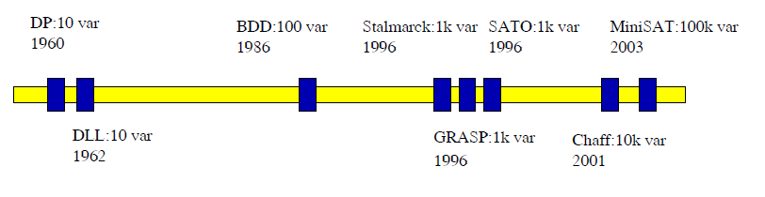
SAT Solvers
The most widely used SAT solver is DPLL
[Davis–Putnam–Logemann–Loveland (DPLL)]
Basic approach: depth-first search
Try an assignment, backtrack if failed
Many improvements over the years

Slide 8
SAT
Planning
Diagnosis
CSPs
Puzzles
Model Checking

Slide 9
Conjunctive Normal Form (CNF)
A clause is a disjunction of literals
Example: (l₁ Or l₃ Or Not(l₅)) is a clause
CNF is a set of clauses connected by an And
CNF Examples
(l₁ Or l₃ Or Not(l₅)) is a CNF with one clause
(l₂ Or Not(l₆)) And (l₃ Or l₄ Or l₅) And (Not(l₂))
Every logical formula can be converted to a CNF

Slide 10
SAT and CNF
SAT solvers usually start by converting to CNF
Example: (C₁ And C₂ And C₃ And C₄) is True
iff C₁ is True, and C₂ is True …
Why is this observation helpful?
Observation:
A CNF is satisfiable iff all its clauses are satisfied

Slide 11
CSP as a SAT Problem
SAT solvers are often used to solve CSP
Compile every constraint to a logical formula
Every constraint is at least one clause
Constraints
David either passes of fails the exam
Logical Formula
Pass(David ) Or Not(Pass(David )
If David studies he will passes the exam
Study(David)→Pass(David)

Slide 12
MAX-SAT
What if not all constraints can be met?
In CNF: what if all the clauses can’t be satisfied?
➔ SAT will return False
Common practice:
Prefer to violate the least amount of constraints
In CNF: satisfy the maximal num. of clauses
The MAX-SAT problem:
Given a CNF formula f, return the maximal number of clauses that can be satisfied

Slide 13
MAX-SAT Variants
Soft and hard constraints
Some clauses must be satisfied (hard constraints)
Other clauses may not be (soft constraints)
Try to satisfy maximal number of soft constraints
Weighted MAX-SAT
….
Approaches for solving MAX-SAT
Search (A*/IDA*)
Iterative calls to a SAT solver
….

Slide 14
Agenda
What is the SATisfiability problem
Max SATisfiability (MAX-SAT)
Diagnosis and SAT
Minimal diagnosis with MAX SAT
Efficient SAT compilation of the MBD problem

Slide 15
Model-Based Diagnosis
Find the reason of a problem
given observed symptoms
and a model of how the system behaves

Slide 16
Weak Fault Model
Find the reason of a problem
given observed symptoms
and a model of how the system behaves
when all the components are healthy
No knowledge of how faulty components behave

Slide 17
Diagnosis Engine
Observations
System Model
Diagnosis Engine
Diagnoses
Diagnoses
Diagnoses

Slide 18
Concept: Diagnose with SAT
Observations
System Model
Diagnosis Engine
Compile to CNF
SAT Solver
Diagnoses
Diagnoses
Diagnoses

Slide 19
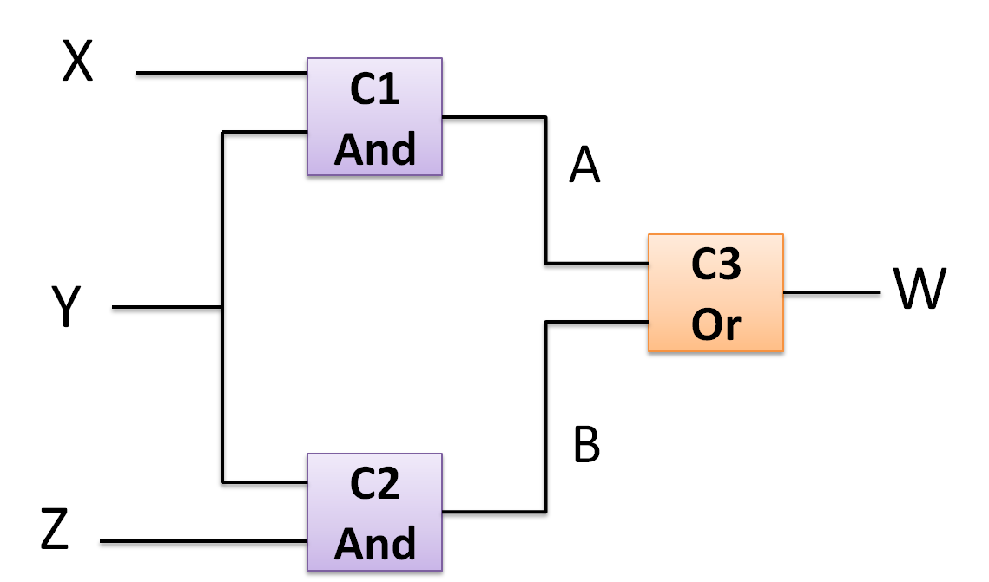
Compile to CNF
A CNF is composed of literals and clauses
What are the CNF literals?
What can be true (1) or false (0)?

Slide 20
System Description→ CNF
X
C1
And
Two options:
If And1 is healthy, then Z=X And Y
Else, no knowledge on Z (weak-fault model)
We need health variables!
Z
Y

Slide 21
Health Variables
X
C1
And
The health variable h(C1) is True if C1 is healthy
Two options:
If And1 is healthy, then Z=X And Y
Else, no knowledge on Z (weak-fault model)
h(C1)→(Z=(X And Y))
Z
Y

Slide 22
System Description→ CNF (cont.)
A clause Fi for every components Ci
Fi=h(Ci)→(normal behavior of Ci)
The system description is: F1 And F2 And …
CNF!

Slide 23
Example #1
X
C1
And
A
C3
Or
W
Y
B
C2
And
Z

Slide 24
Example #1 (cont.)
(A↔(X∧Y))
A | Y | X
0 | 0 | 0
0 | 1 | 0
0 | 0 | 1
1 | 1 | 1
X
C1
And
A
C3
Or
W
Y
B
C2
And
Z

Slide 25
Example #1 (cont.)
F1: (h(C1)→(A↔(X∧Y)))
X
C1
And
A
C3
Or
W
Y
B
C2
And
Z

Slide 26
F1: (h1→(A↔(X∧Y)))
1F | Y | X | A | h1
1 | 0 | 0 | 0 | 0
1 | 1 | 0 | 0 | 0
1 | 0 | 1 | 0 | 0
1 | 1 | 1 | 0 | 0
1 | 0 | 0 | 1 | 0
1 | 1 | 0 | 1 | 0
1 | 0 | 1 | 1 | 0
1 | 1 | 1 | 1 | 0
1 | 0 | 0 | 0 | 1
1 | 1 | 0 | 0 | 1
1 | 0 | 1 | 0 | 1
0 | 1 | 1 | 0 | 1
0 | 0 | 0 | 1 | 1
0 | 1 | 0 | 1 | 1
0 | 0 | 1 | 1 | 1
1 | 1 | 1 | 1 | 1

Slide 27
Example #2
X
C1
And
A
C3
Or
W
Y
C2
And
B
Z
F1: (h(C1)→(A↔(X∧Y)))
In CNF form:
F1: (Not(h(C1) Or X Or Not(A)) ∧
(Not(h(C1) Or Y Or Not(A)) ∧
(Not(h(C1) Or A Or Not(X) Or Not(Y))

Slide 28
Example #2 (cont.)
X
C1
And
A
C3
Or
W
Y
C2
And
B
Z
F1: (¬h1 v X v ¬A) ∧ (¬h1 v Y v ¬A) ∧ (¬h1 v ¬X v ¬Y v A)
F2: (¬h2 v Y v ¬B) ∧ (¬h2 v Z v ¬B) ∧ (¬h2 v ¬Y v ¬Z v B)
F3: (¬h3 v ¬A v W) ∧ (¬h3 v ¬B v W) ∧ (¬h3 v A v B v ¬W)

Slide 29
Observations → CNF
Observation =
an assignment to inputs and outputs
Example:
An observation:
X=1, Y=1, Z=0, W=0
The corresponding CNF:
X And Y And Not(Z) And W
Simply assign the values

Slide 30
Diagnose with SAT
Observations
System Model
Diagnosis Engine
Observations
→ CNF
Compile to CNF
System Description → CNF
SAT Solver
A satisfying assignment is a diagnosis
The diagnosis contains all Ci for which h(Ci)=False
Diagnoses
Diagnoses

Slide 31
Finding Minimal Diagnoses with SAT
Problem:
All health variables=False is a trivial diagnosis
Minimal diagnoses are preferred (Occam’s,…)
How to compute minimal diagnoses with SAT?
➔How to maximize the #Ci for which h(Ci)=True?

Slide 32
MERIDIAN (Feldman et. al. ‘09)
For every component Ci add the clause h(Ci)
Run MAX-SAT variant where
Hard constraints are the model and observations
Soft constraints are the h(Ci) clauses
Maximal # of h(Ci) satisfied = minimal diagnosis
How to generate more than one diagnosis?

Slide 33
Example #3
X
C1
And
A
C3
Or
W
Y
C2
And
B
Z
Hard constraints:
(¬h1 v X v ¬A) ∧(¬h1 v Y v ¬A) ∧(¬h1 v ¬ X v ¬Y v A) ∧
(¬h2 v Y v ¬B) ∧(¬h2 v Z v ¬B) ∧(¬h2 v ¬ Y v ¬Z v B) ∧
(¬h3 v ¬A v W) ∧(¬h3 v ¬B v W) ∧(¬h3 v A v B v ¬W)
Soft constraints: (h1) ∧(h2) ∧(h3)

Slide 34
Example #3 – First Observation
X=1
C1
And
A
C3
Or
W=0
Y=1
C2
And
B
Z=0

Slide 35
Example #3 (cont.)
X=1
C1
And
A
C3
Or
W=0
Y=1
C2
And
B
Z=0
Hard constraints
(¬h1 v X v ¬A) ∧(¬h1 v Y v ¬A) ∧(¬h1 v ¬ X v ¬Y v A) ∧
(¬h2 v Y v ¬B) ∧(¬h2 v Z v ¬B) ∧(¬h2 v ¬ Y v ¬Z v B) ∧
(¬h3 v ¬A v W) ∧(¬h3 v ¬B v W) ∧(¬h3 v A v B v ¬W)
Soft constraints: (h1) ∧(h2) ∧(h3)

Slide 36
Example #3 (cont.)
X=1
C1
And
A
C3
Or
W=0
Y=1
C2
And
B
Z=0
Hard constraints:
(¬h1 v 1 v ¬A) ∧(¬h1 v 1 v ¬A) ∧(¬h1 v 0 v 0 v A) ∧
(¬h2 v 1 v ¬B) ∧(¬h2 v 0 v ¬B) ∧(¬h2 v 0 v 1 v B) ∧
(¬h3 v ¬A v 0) ∧(¬h3 v ¬B v 0) ∧(¬h3 v A v B v 1)
Soft constraints: (h1) ∧(h2) ∧(h3)

Slide 37
Example #3 (cont.)
X=1
C1
And
A
C3
Or
W=0
Y=1
C2
And
B
Z=0
Hard constraints:
(¬h1 v A) ∧(¬h2 v ¬B) ∧(¬h3 v ¬A) ∧(¬h3 v ¬B)
Soft constraints: (h1) ∧(h2) ∧(h3)

Slide 38
Example #3 (cont.)
X=1
C1
And
A
C3
Or
W=0
Y=1
C2
And
B
Z=0
Hard constraints:
(¬h1 v A) ∧(¬h2 v ¬B) ∧(¬h3 v ¬A) ∧(¬h3 v ¬B)
Soft constraints: (h1) ∧(h2) ∧(h3)
Solution: h1=0, h2=1, h3=1, A=0, B=0

Slide 39
Example #3 (cont.)
X=1
C1
And
A
C3
Or
W=0
Y=1
C2
And
B
Z=0
Hard constraints:
(¬h1 v A) ∧(¬h2 v ¬B) ∧(¬h3 v ¬A) ∧(¬h3 v ¬B) ∧ (h1)
Soft constraints: (h1) ∧(h2) ∧(h3)
Solution: h1=1, h2=1, h3=0, A=1, B=0

Slide 40
Example #3 (cont.)
X=1
C1
And
A
C3
Or
W=0
Y=1
C2
And
B
Z=0
Hard constraints:
(¬h1 v A)∧(¬h2 v ¬B)∧(¬h3 v ¬A)∧(¬h3 v ¬B)∧(h1)∧(h3)
Soft constraints: (h1) ∧(h2) ∧(h3)
No solution exists!

Slide 41
Example #3 - Conclusion
X=1
C1
And
A
C3
Or
W=0
Y=1
C2
And
B
Z=0
There are two minimal diagnoses:
C1 is unhealthy
C3 is unhealthy

Slide 42
Strong Fault Model SAT Compilation
X
A binary health variable is not enough:
If And1 is healthy, then Z=X And Y
Else, if And1 is stuck-at-zero, then Z=0
Else, if And1 is stuck-at-one, then Z=1
Else, if And1 is flip, then Z=Not(X And Y)
C1
And
Z
Y

Slide 43
Strong Fault Model SAT Compilation
X
Literal for every behavior mode
health(C1)→(Z=(X And Y))
stackAtZero(C1)→(Z=0)
stackAtOne(C1)→(Z=1)
Flip(C1)→(Not(Z=(X And Y)))
C1
And
Z
Y

Slide 44
Strong Fault Model SAT Compilation
Clauses to verify only one mode is chosen
¬(h(C1)) v ¬(stackAtZero(C1))
¬(h(C1)) v ¬(stackAtOne(C1))
¬(h(C1)) v ¬(flip(C1))
¬(stackAtZero(C1)) v ¬(stackAtOne(C1))
¬(stackAtZero(C1)) v ¬(flip(C1))
¬(stackAtOne(C1)) v ¬(flip(C1))
Clauses to verify at least one mode is True
h(C1) v stackAtZero(C1) v stackAtOne(C1) v flip(C1)

Slide 45
However, this did not work

Slide 46
Agenda
What is the SATisfiability problem
Max SATisfiability (MAX-SAT)
Diagnosis and SAT
Minimal diagnosis with MAX SAT
Efficient SAT compilation of the MBD problem

Slide 47
Reminder: Minimal Cardinality
Large systems may have many diagnoses
Common assumption:
Smaller diagnoses are more likely
Diagnosis size = #faults = cardinality
Smallest diagnosis = min. cardinality diagnosis
Can have many min. cardinality diagnoses

Slide 48
Finding Minimal Cardinality Diagnoses
Why do we want to find all of them?
To choose intelligently what to do next
Naïve approach: find all diagnoses, then prune
Obviously wasteful

Slide 49


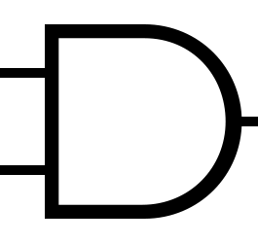
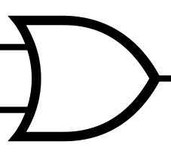

Basic modeling
A=1
Z1
B=0
X1
D=0
X2
C=1
A2
Z3
Z2
O1
E=0
A1

Slide 50
Basic modeling
A=1
Z1
B=0
X1
D=0
X2
C=1
A2
Z3
Z2
O1
E=0
A1
{A,C,H_{A1}, H_{A2}, H_{o1}} - true, {B,D,E, Z₁, Z₂, Z₃, H_{x1},H_{x2}} –false →∆ = {X₁,X₂}
{A,C, Z₁, Z₃, H_{A1}, H_{A2}, H_{x1}, H_{x2}} - true, {B,D,E, Z₂,H_{o1}} –false →∆ = {O₁}

Slide 51
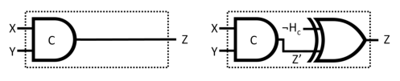
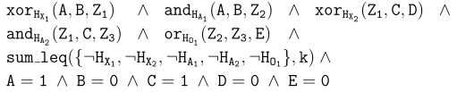
Further SAT Compilation Trick
Since we are looking for min. card. diagnosis, we can use XOR instead of entailment

Slide 52
Preprocessing
Observation: diagnosis has two stages
1) Read the system description (the model)
2) Obtain observations and produce diagnosis
Stage 1 occurs once for a system model
Stage 2 may occur many times
➔Should invest time to analyze the system model

Slide 53
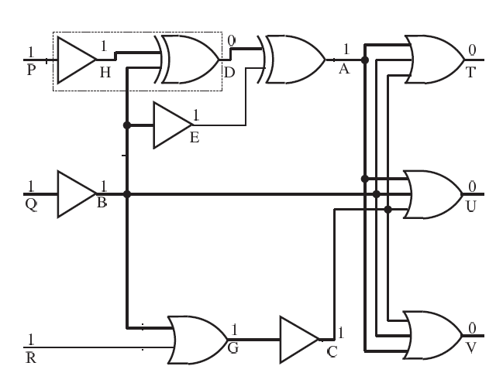
Abstraction

Slide 54
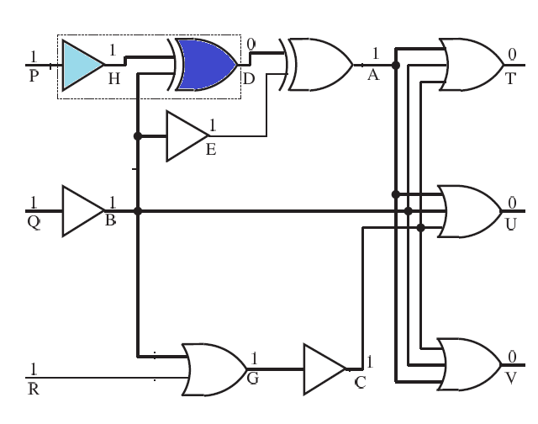
Dominated and Dominator
Dominated must pass via dominator to output

Slide 55
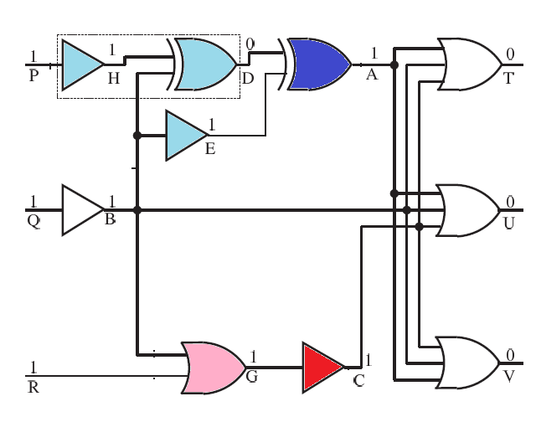
Dominators and Dominated
Cones

Slide 56
How does cones help to diagnose?

Slide 57
Dominators and Dominated
10 Components
Cones

Slide 58
Dominators and Dominated
6 Components !

Slide 59
HDAS (Siddiqi & Huang ‘07)
Diagnosis in two steps
Find top-level diagnoses
Diagnose faulty cones to get full diagnosis
Top-level diagnoses
Consider a cone as a single component
Assume all dominated components are healthy

Slide 60
Example

Slide 61
Example
Cone 1
Cone 2

Slide 62
Stage 1: Find Top-Level Diagnosis
Faulty
Cone 1
Faulty
Cone 2

Slide 63
Stage 2: Diagnose faulty cones
Faulty
Cone 1
Faulty
Cone 2

Slide 64
Stage 2: Diagnose faulty cones
Faulty
Faulty
Cone 2

Slide 65
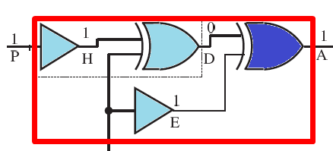
Stage 2: Diagnose faulty cones
Faulty
Faulty

Slide 66
Stage 2: Diagnose faulty cones
Faulty
Faulty

Slide 67
Stage 2: Diagnose faulty cones
Faulty
Faulty

Slide 68
Stage 2: Diagnose faulty cones
Faulty
Faulty

Slide 69
Stage 2: Diagnose faulty cones
4 Possible diagnoses!
Faulty
Faulty

Slide 70
Example: Top-Level Diagnosis #2
Faulty
Cone 1
Faulty
Cone 2

Slide 71
Example: Top-Level Diagnosis #2
Faulty
How many diagnoses can stem from this top level diagnosis?
Faulty

Slide 72
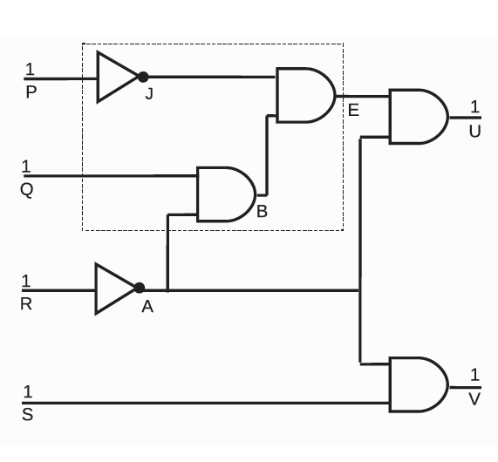
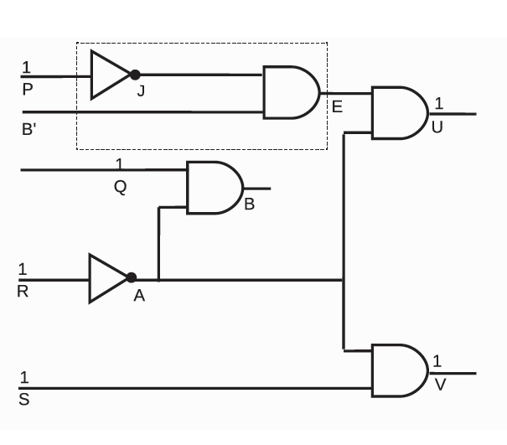
When will this not help?
How to find the top-level diagnoses?
What if there are few small cones?
Partial solution: node splitting (DCAS, Siddiqi ’11)

Slide 73
Intelligent System Partition
Example:
|Components|=100
There are at most 10 faults (i.e., min. card.<=10)
Brute force complexity: O(100¹⁰)
What if we can partition the bound as follows:
In the first 50 components there are at most 5 faults
In the last 50 components there are at most 5 faults
What is the brute force complexity?
O(50⁵*50⁵)=O((50⁵)²)=O(50¹⁰) << O(100¹⁰)

Slide 74
Sections
S₃
S₂
O₁
C₆
C₅
S₄
C₁
C₂
C₇
C₈
O₂
C₃
C₄
C₉
C₁₀
O₃
S₁
S₅
Bound on number of faults in a section
# affected system outputs
# section outputs

Slide 75
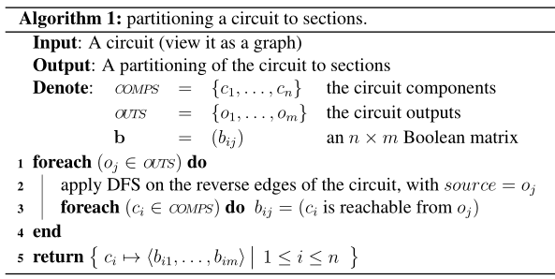
Computing sections: O(n²m)

Slide 76
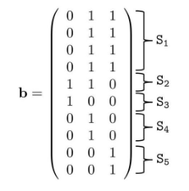
Computing sections: O(n²m)
S₃
S₂
C₆
O₁
C₅
S₄
C₁
C₂
C₇
C₈
O₂
C₃
C₄
C₉
C₁₀
O₃
S₁
S₅

Slide 77
Exploiting Bounds on Diagnosis Size
Worst case behavior for diagnosis algorithm
Try every assignment to health variables
Complexity: 2^{|Components|}
If we knew that only one component is faulty?
Complexity: |Components|
What if at most k components are faulty?
Complexity exponential in k (and not |Components|)
How to bound the #faulty diagnoses?

Slide 78
Finding Bounds on Min. Card.

Slide 79
Finding Bounds on Min. Card.
Option 1: # outputs

Slide 80
Finding Bounds on Min. Card.

Slide 81
Finding Bounds on Min. Card.

Slide 82
Finding Bounds on Min. Card.

Slide 83
Finding Bounds on Min. Card.
Option 2:# components affecting faulty outputs

Slide 84
Finding Bounds on Min. Card.
Option 1: # outputs
Option 2:# components affecting faulty outputs
Option 3: # faulty outputs (+correction)
#faulty outputs is always smaller

Slide 85
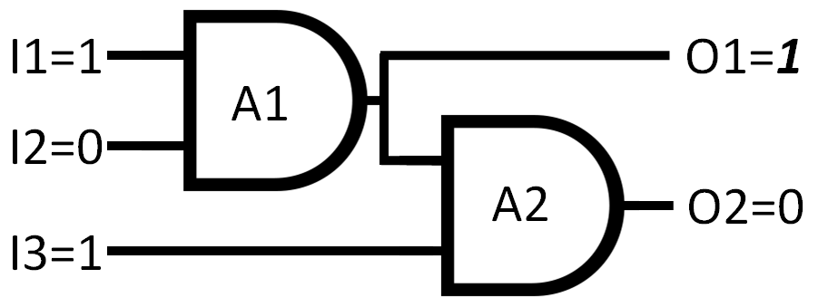
#Faulty Outputs is Wrong!
Solution:
Flip output during propagation

Slide 86
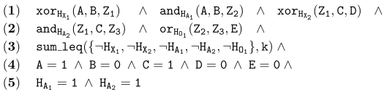
Compiling constraints to CNF
Equi-propagation: identifying equalities between literals
A=1
Z1
B=0
X1
D=0
X2
C=1
A2
Z3
Z2
O1
E=0
A1
bound
observations
Dominated are healthy

Slide 87
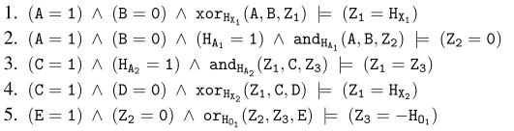
Equi-propagation:

Slide 88

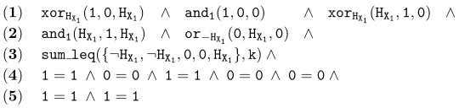
Equi-propagation:
Propagated values:
Assigning the new values to the original clauses

Slide 89
Finally, we get:
For k=1: H_{X1}= 1

Slide 90
Improved SAT Diagnosis Process
Without the observations
Offline Compilation
Identify cones
Identify sections, produce initial fault bounds
Online Compilation
Find faulty outputs with propagation (+ bound correction)
Diagnosis Process
Iterative SAT calls until size of minimal cardinality is found
Encode CNF with system and section bounds on # of faults
Find diagnoses by expanding cones separately
Iterative SAT calls to find all minimal cardinality top-level diagnoses

Slide 91
State-of-the-art performance!

Slide 92
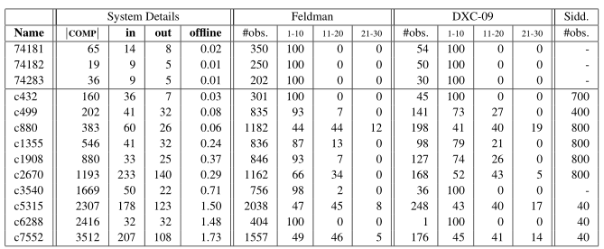
The Benchmark suite: systems 74XXX and ISCAS-85

Slide 93
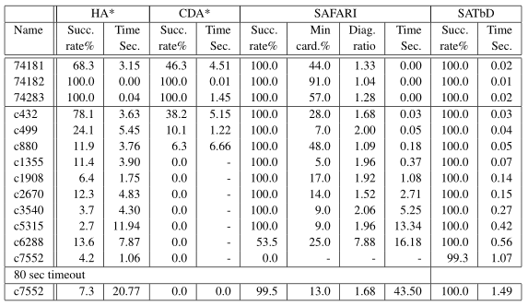
Single minimal cardinality diagnosis, Feldman’s scenarios

Slide 94
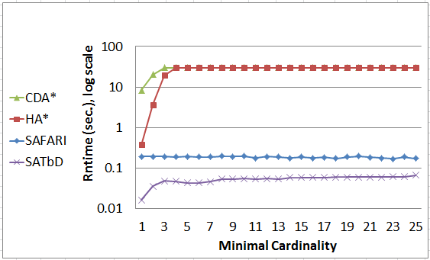
Runtimes as a function of the size of the minimal cardinality diagnosis (DXC with System c880 )

Slide 95
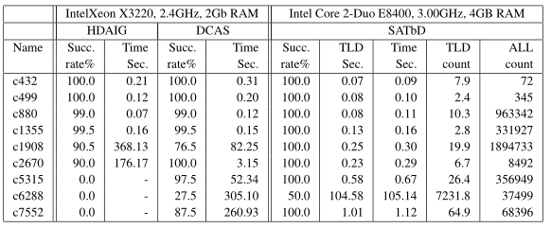
Siddiqi’s scenario set: search for ALL minimal cardinality diagnoses

Slide 96
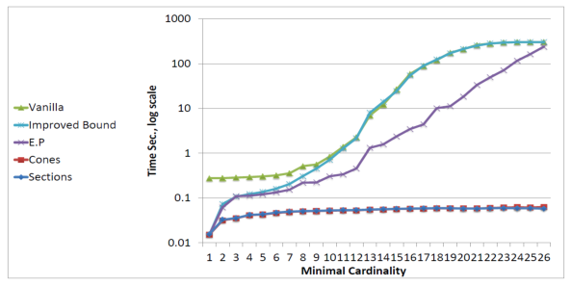
Impact of the different settings on the search for a single minimal cardinality diagnosis for system c880

Slide 97
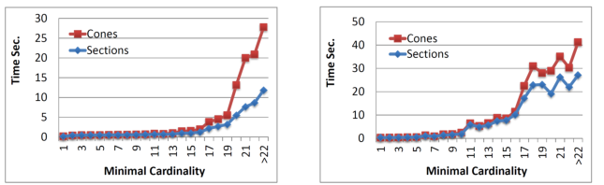
Impact of sections and cones on the search for a single minimal cardinality diagnosis (left) and on the search for all TLDs (right) using system c7552

Slide 98
Discussion Points
What is harder: diagnosis or SAT?
More intelligent partition to sections
Better bounds on # of faults
Can we solve SAT with diagnosis?
(Diorama by Feldman et. al. ’09)
….

